Slide 1
Analysis of Airbnb Data Using Power BI
Deeper understanding of Airbnb's operations and draw meaningful insights from the data using Power BI

Slide 2
Objective:
Gain a comprehensive understanding of Airbnb's operational dynamics and derive actionable insights from the data utilizing Power BI tools, including:
Power BI Desktop
Query Editor
DAX Queries

Slide 3
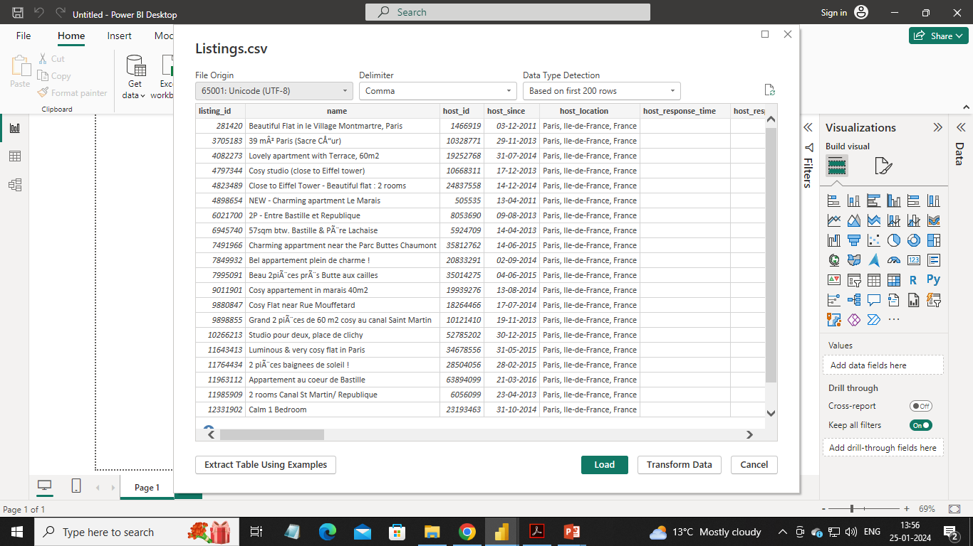
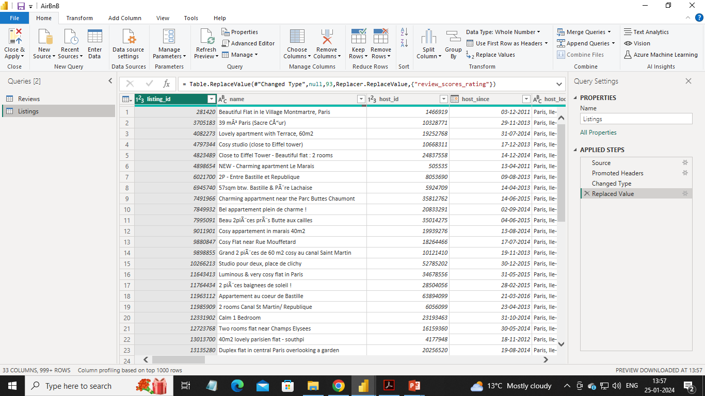
Importing data for the project
Used get data option and imported review and listing files, In Power BI.
Checked and updated data types of columns for the CSV files using power query.

Slide 4
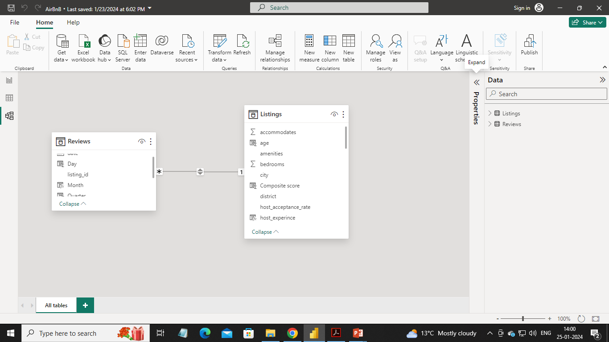
Data Model
Created a data model, using both csv files for AirBnb Analysis.
Used listing_id as connecting field.

Slide 5
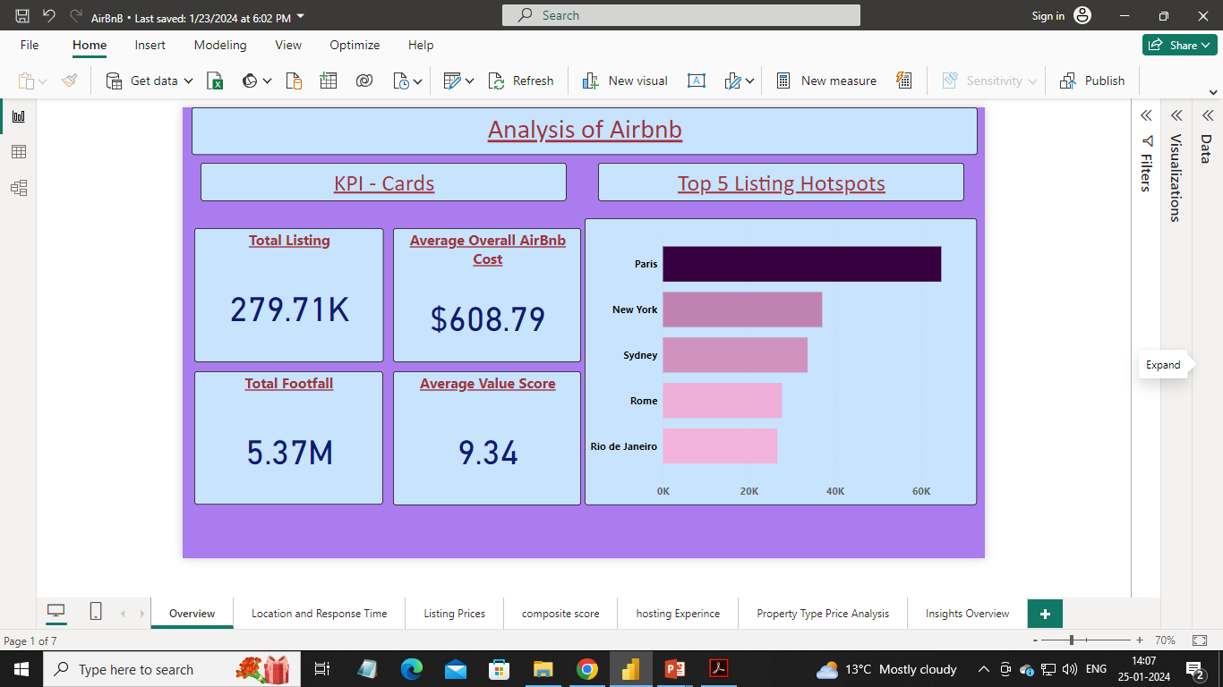
Created Overview Report:

Slide 6
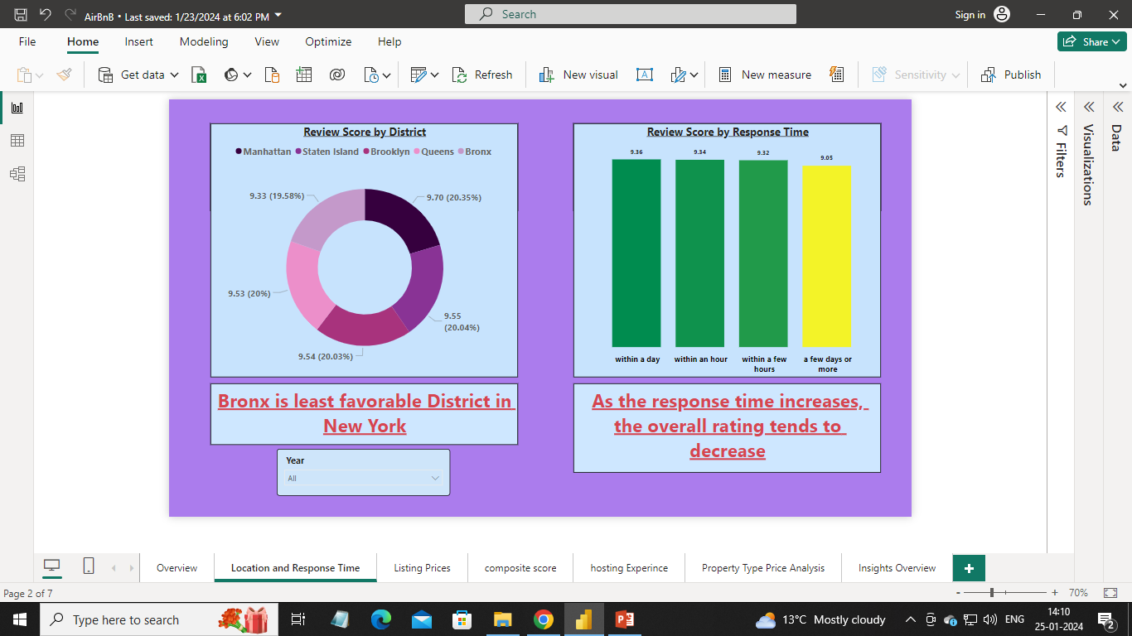
Analyzed District Location Scores and Host Response Time with year slicer option:

Slide 7
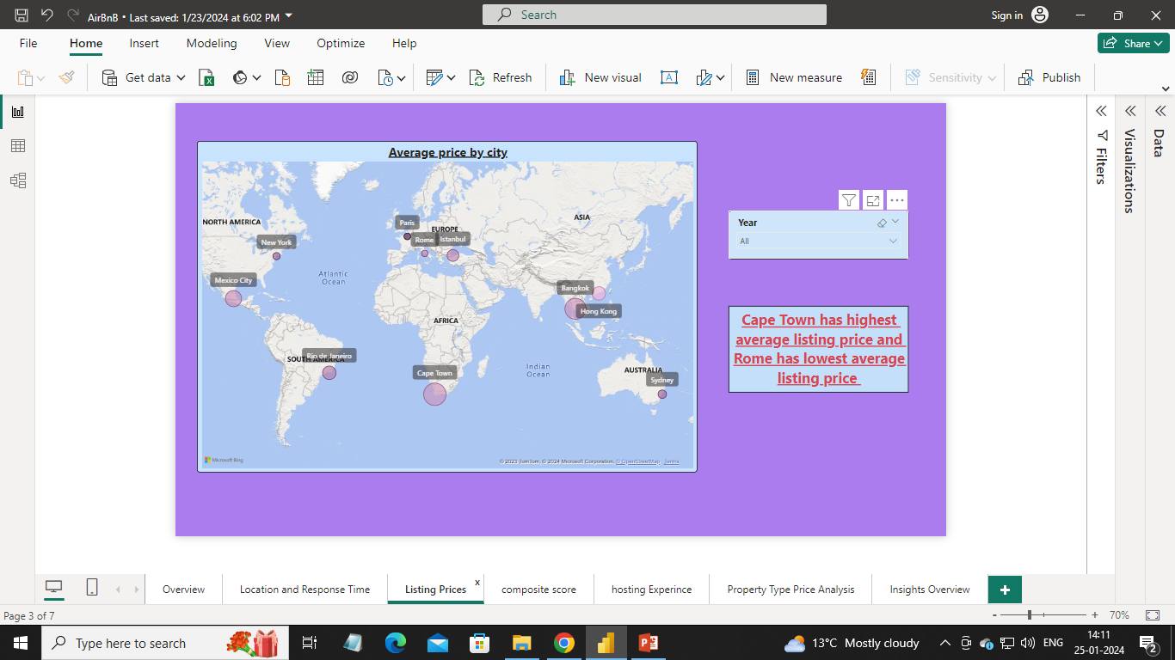
Visualized Airbnb listing prices with year slicer option:

Slide 8
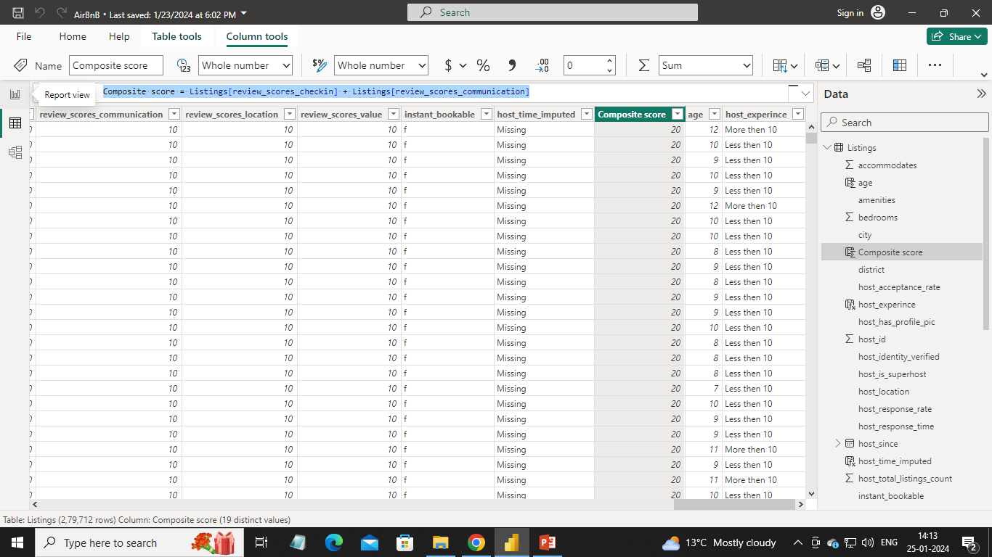
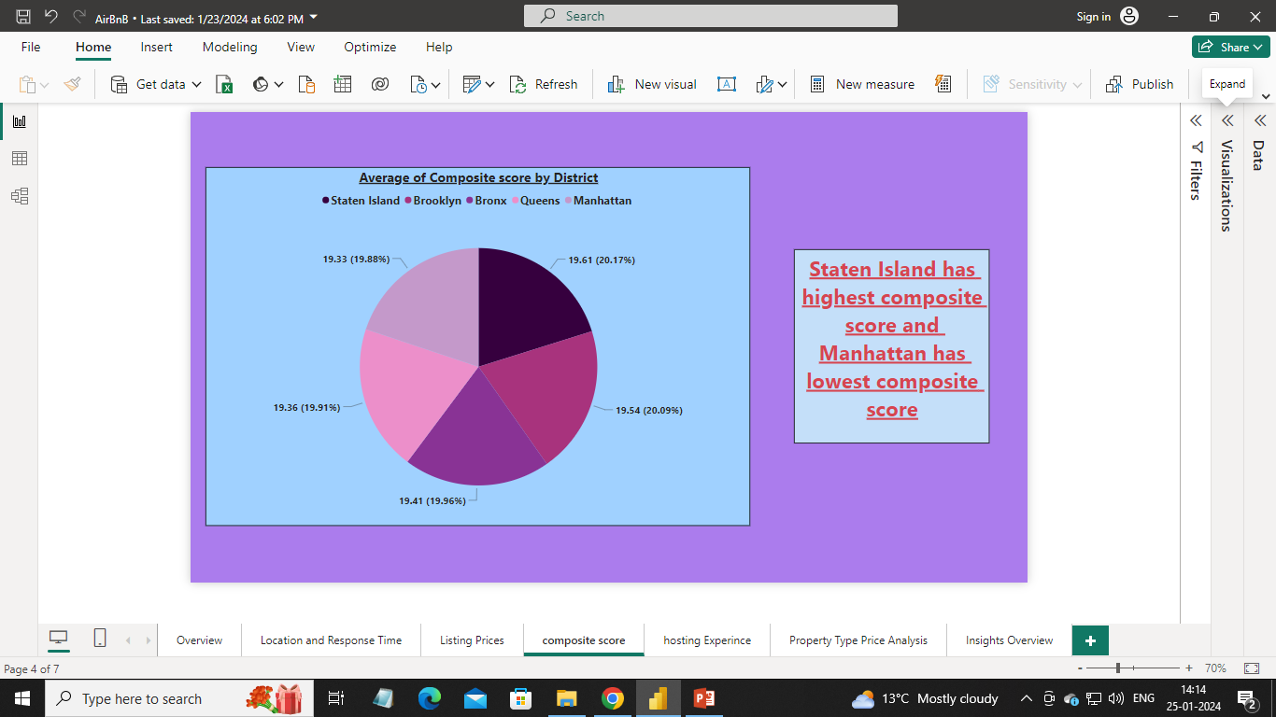
Analyzed composite scores:
Created a composite score column:
Visualized districts using composite score

Slide 9
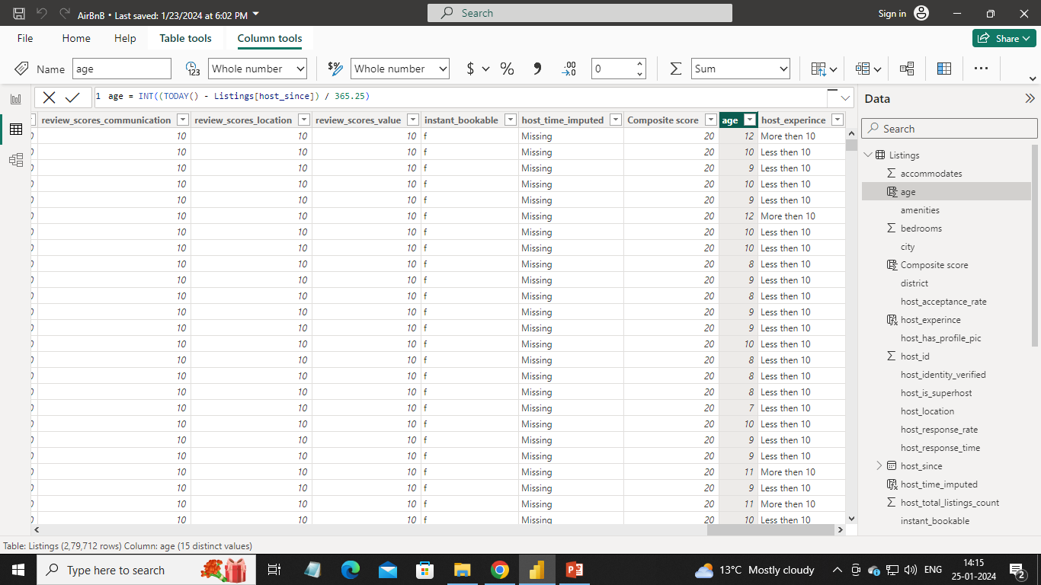
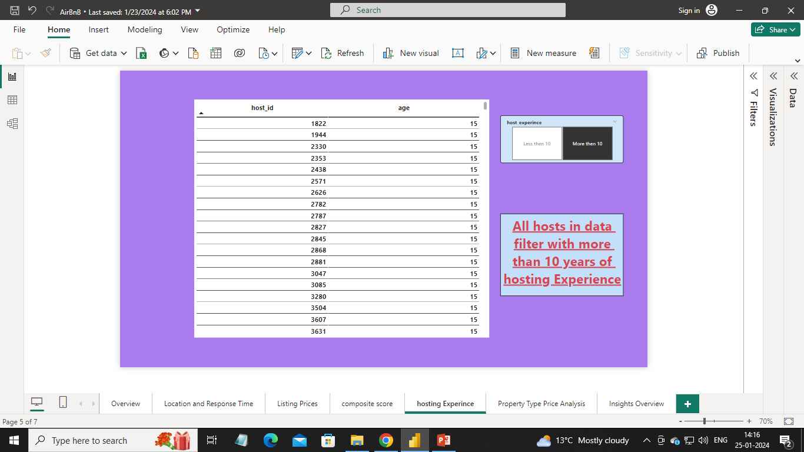
Analyzed listing age and host tenure:
Created a age and host_experience column:
Visualized listing age and host tenure:

Slide 10
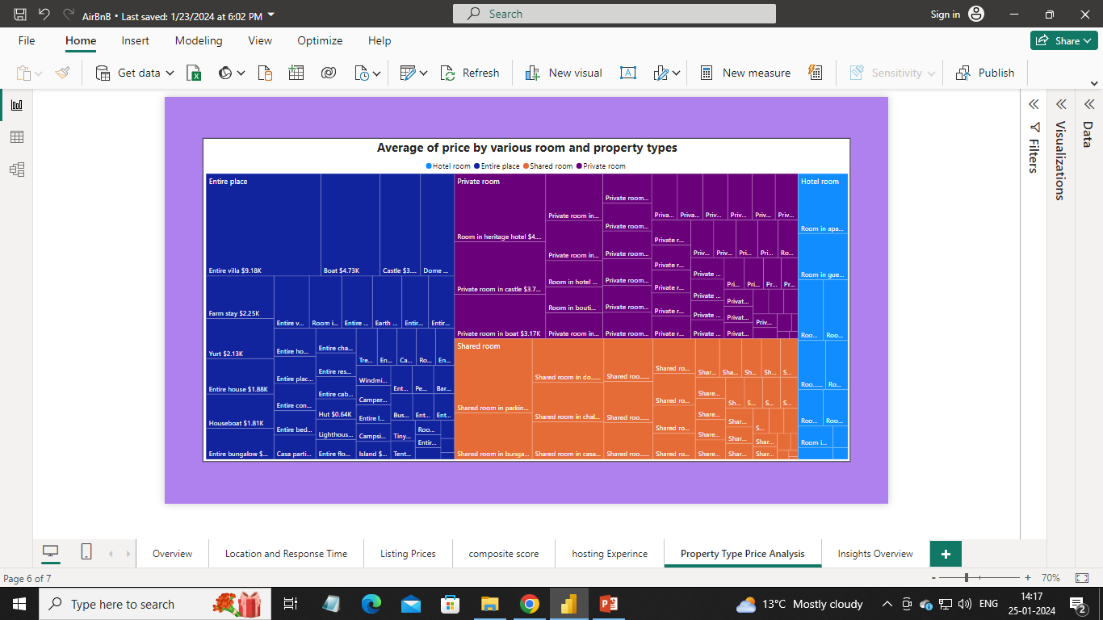
Visualized Airbnb Property Type Price Analysis:

Slide 11
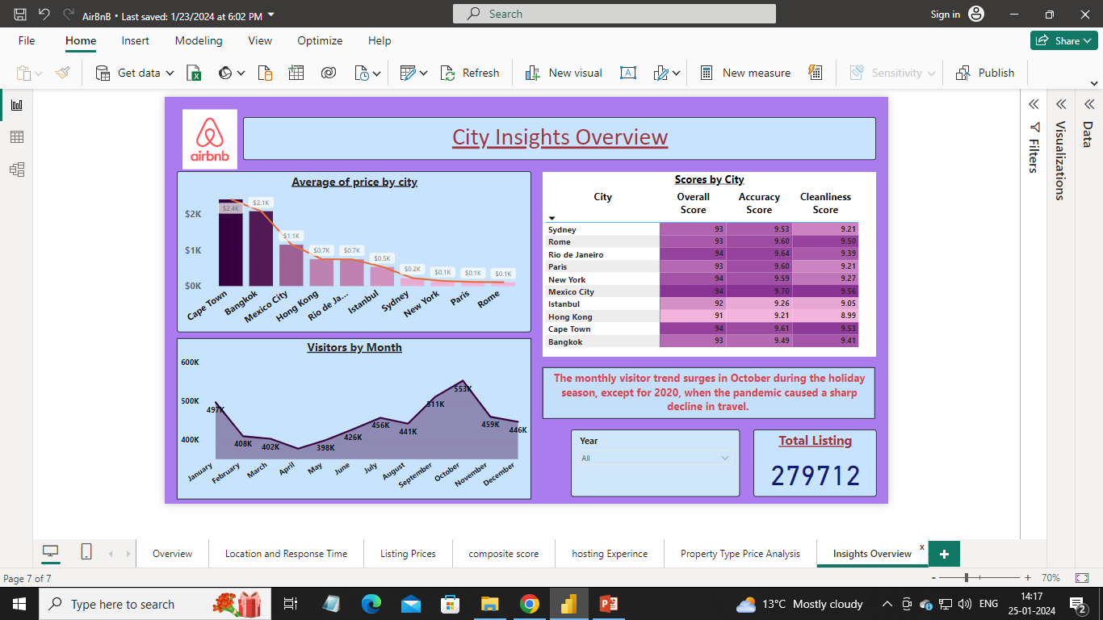
Creadted a Comprehensive City Insights Report:

Slide 12
Conclusion:
Bronx is least favorable District in New York
As the response time increases, the overall rating tends to decrease
Cape Town has highest average listing price and Rome has lowest average listing price
Staten Island has highest composite score and Manhattan has lowest composite score
The monthly visitor trend surges in October during the holiday season, except for 2020, when the pandemic caused a sharp decline in travel.

Slide 13
Please ask any Questions?

Slide 14
Thank You!!

